Slide 1
Management of Deep Mycoses
Facilitator
Dr.Moledina
Presenters
Dr Emmanuel Lusomi
Dr Mariam Digelo

Slide 2
Outline
Introduction
Classification of Fungal Infections
Risk Factors for Acquiring Fungal Infections
Clinical Syndromes — Pathogen by Pathogen
An Overview of Antifungals
Case Scenarios
Refferences

Slide 3
Introduction
Deep mycoses are serious, chronic fungal infections that penetrate beyond the superficial layers of the skin to invade the subcutaneous tissues, deep organs, or multiple systemic tracts of the body
They affect ~300 million people annually
Responsible for >1.5 million deaths — exceeding tuberculosis mortality in immunocompromised populations
Rajasingham R et al. Lancet Infect Dis 2022; Bongomin F et al. J Fungi 2017; Denning DW et al. Lancet Infect Dis 2023
Notes:
~70% HIV/AIDS assocaited
Rising incidence driven by expanding immunosuppressed populations: HIV/AIDS, transplant recipients, hematologic malignancies, and prolonged ICU stays.
Cryptococcosis: Leading cause of meningitis in HIV+ adults
Histoplasmosis: Under-recognised; bat caves & agriculture exposure
Candidiasis: Dominant in ICU, post-surgical & immunosuppressed patients
Aspergillosis: Rising with TB sequelae & prolonged steroid use

Slide 4
Classification: Endemic vs Opportunistic
ENDEMIC (Primary Pathogens)
OPPORTUNISTIC Pathogens
Cause disease in immunocompetent hosts; geographically restricted
Examples: Histoplasma capsulatum, Coccidioides spp., Blastomyces dermatitidis, Paracoccidioides, Talaromyces marneffei
Cause disease primarily in immunocompromised hosts
Examples: Candida spp., Aspergillus spp., Cryptococcus neoformans, Pneumocystis jirovecii, Mucorales
NOTE: Immunocompromised hosts are susceptible to BOTH categories
Ref: Kauffman CA. Diagnosis of Endemic Mycoses. CID 2011; 52(S4):S219–S225. | WHO Fungal Priority Pathogens List. Geneva: WHO, 2022

Slide 5
Risk Factors for Acquiring Fungal Infections
ENVIRONMENTAL FACTORS
HOST-RELATED RISK FACTORS
  HIV/AIDS (CD4 < 200 cells/µL)
  Prolonged neutropenia — haematologic malignancies, chemotherapy
  Solid organ or haematopoietic stem cell transplantation
  Prolonged corticosteroid use (≥ 20 mg prednisone/day > 3 weeks)
  Biologic therapy: TNF-α inhibitors, JAK inhibitors
  Diabetes mellitus (especially uncontrolled — risk for mucormycosis)
Geographic residence / travel (endemic mycoses)
Occupational exposure: farmers, construction workers, spelunkers
Broad-spectrum antibiotic use — Candida overgrowth
Indwelling CVC, ICU stay, TPN — invasive candidiasis
Ref: Kullberg BJ, Arendrup MC. Invasive Fungal Disease in the Patient with Leukaemia. Haematologica 2015; 100:991–997. | Pappas PG et al. IDSA Guidelines for Candidiasis. CID 2016; 62(4):e1–50.

Slide 6
Histoplasmosis — Overview & Risk Factors
Chronic granulomatous disease caused by the thermally dimorphic fungus Histoplasma capsulatum (HC.var. capsulatum- classical or American histoplasmosis , HC var. duboisii -African histoplasmosis)
Common Risk Factors
  Exposure to bird/bat droppings — cave exploration, demolition, agricultural work
  HIV/AIDS — reactivation disease (CD4 < 150 cells/µL),
  Solid organ transplant, anti-TNF therapy, haematologic malignancy
Pathogenesis
  Inhalation of microconidia → phagocytosed by macrophages → haematogenous spread in immunocompromised

Slide 7
Histoplasmosis — Clinical Features
Clinical Syndrome | Clinical Presentation
Acute Pulmonary Histoplasmosis | Flu-like illness, cough, fever, myalgias Self-limiting in > 90%z
Chronic Cavitary Pulmonary Histoplasmosis | 2–8% of patients with pulmonary histoplasmosis Resembles TB — upper lobe cavities, haemoptysis
Disseminated Histoplasmosis | Fever, weight loss, hepatosplenomegaly, pancytopenia Mucocutaneous ulcers (oral/GI), adrenal involvement CNS histoplasmosis: meningitis, brain abscess (rare but severe) Mediastinal complications: fibrosing mediastinitis, lymphadenopathy
Ref: Wheat LJ et al. IDSA Guidelines: Histoplasmosis. CID 2007; 45(7):807–825. | Deepe GS. Histoplasma capsulatum. In: Mandell GL et al. (eds). Principles and Practice of Infectious Diseases, 9th ed. Elsevier, 2019.
Notes:
COMPLICATIONS: ARDS, haemorrhagic pericarditis, adrenal insufficiency

Slide 8
Histoplasmosis — Diagnosis & Treatment
Diagnosis
  Urine Histoplasma antigen — most sensitive for disseminated disease (> 90%)
  Serology (complement fixation, immunodiffusion) — useful for pulmonary
  Culture (gold standard) — weeks; BAL or bone marrow biopsy
  Histopathology: small intracellular yeast within macrophages
Treatment
  Mild-moderate: Itraconazole 200 mg TDS × 3 days, then BD × 12 months
  Severe / CNS: LAmB 3-5 mg/kg/day × 2 weeks → step down to Itraconazole
  Secondary prophylaxis in HIV: Itraconazole 200 mg OD until CD4 > 150 × 6 months
IDSA 2024, Ocansey BK, Kosmidis C, Ayanlowo OO, Agyei M, Dorkenoo AM, Oladele RO, Darre T, Denning DW. Histoplasmosis in Africa: Current perspectives, knowledge gaps, and research priorities. PLoS Negl Trop Dis. 2022 Jun;16(6):e0010486. doi:10.1371/journal.pntd.0010486.
Notes:
BAL- Bronchoalveolar lavage

Slide 9
Coccidioidomycosis — Overview & Risk Factors
Pathogen: Coccidioides immitis / posadasii (dimorphic fungus)
Geography: SW USA (Arizona, California), N. Mexico, South America — 'Valley Fever’
Common Risk Factors
  Dust/soil disturbance — construction, farming, military exercises
  Immunocompromised: HIV (CD4 < 250), transplant, corticosteroids, DM
  Pregnancy (3rd trimester) — increased risk of dissemination
  African-American and Filipino ethnicity — higher risk of dissemination
PATHOGENESIS (brief)
  Inhalation of arthroconidia → spherules in lung → haematogenous dissemination in immunocompromised
Ref: Galgiani JN et al. IDSA Guidelines: Coccidioidomycosis. CID 2016; 63(6):e112–e146
Notes:
Migration and tourism are raising concerns that CM will grow beyond a regional disease to a global problem

Slide 10
Coccidioidomycosis — Clinical Features
Clinical Syndrome | Clinical Presentation
Acute Pulmonary CM | Fever, cough, chest pain, fatigue; erythema nodosum/multiforme (good prognostic sign) Immunologic manifestations: Arthralgias, myalgias, skin rashes → “desert rheumatism.” Eosinophilia on FBC — characteristic finding
Chronic Pulmonary CM | Pulmonary nodules, thin-walled cavities, Chronic progressive pneumonia -Requires long-term management.
Disseminated CM | (< 1% immunocompetent; much higher in immunocompromised) Bone/joint: osteomyelitis, septic arthritis; Skin: verrucous plaques CNS meningitis — most feared complication; almost invariably fatal if untreated
Ref: Wheat LJ et al. IDSA Guidelines: Histoplasmosis. CID 2007; 45(7):807–825. | Deepe GS. Histoplasma capsulatum. In: Mandell GL et al. (eds). Principles and Practice of Infectious Diseases, 9th ed. Elsevier, 2019.

Slide 11
Coccidioidomycosis — Diagnosis & Treatment
Diagnosis
  Serology: IgM (early) and IgG (CF titre — severity marker); Urine antigen
  Culture (BSL-3); GMS/PAS stain: spherules with endospores
Treatment
  Mild pulmonary (immunocompetent): observation ± Fluconazole 400 mg OD × 3–6 months
  Severe pulmonary / disseminated: Fluconazole 400–800 mg OD or Itraconazole
  Meningitis: Fluconazole 400–800 mg OD LIFELONG — never discontinue
  Intrathecal Amphotericin B for refractory meningitis (historically used)
  Surgical: resection for ruptured cavity, haemoptysis, or persistent lesion
Donovan et al ; Coccidioidomycosis: a growing global concern, J Antimicrob Chemother 2025; 80 Suppl 1: i40–i49 https://doi.org/10.1093/jac/dkaf002
Notes:
COMPLICATIONS
Meningitis requiring lifelong therapy; chronic fibrocavitary lung disease
Hydrocephalus (VP shunting may be required)
Dissemination to bone, skin, and adrenal glands

Slide 12
Blastomycosis — Overview & Risk factors
Pyogranulomatous disease caused by inhalation of Blastomyces conidia or hyphal fragments
It caused by Blastomyces species complex: Common: B. dermatitidis, B. gilchristii, B. helicus, B. percursus, B. emzantsi
Geography: Great Lakes (NA), Mississippi/Ohio River valleys, south-central USA, Africa
Common Risk Factors
  Moist soil, rotting wood, beaver dams — hunters, loggers, campers
  Immunocompromised: HIV, transplant, corticosteroids — more severe disease
Harrison’s Principle of Internal Medicine- 22nd Edition, McBride JA, Gauthier GM, Klein BS. Clinical manifestations and treatment of blastomycosis. Clin Chest Med. 2017 Jun 12;38(3):435–449. doi: 10.1016/j.ccm.2017.04.006.

Slide 13
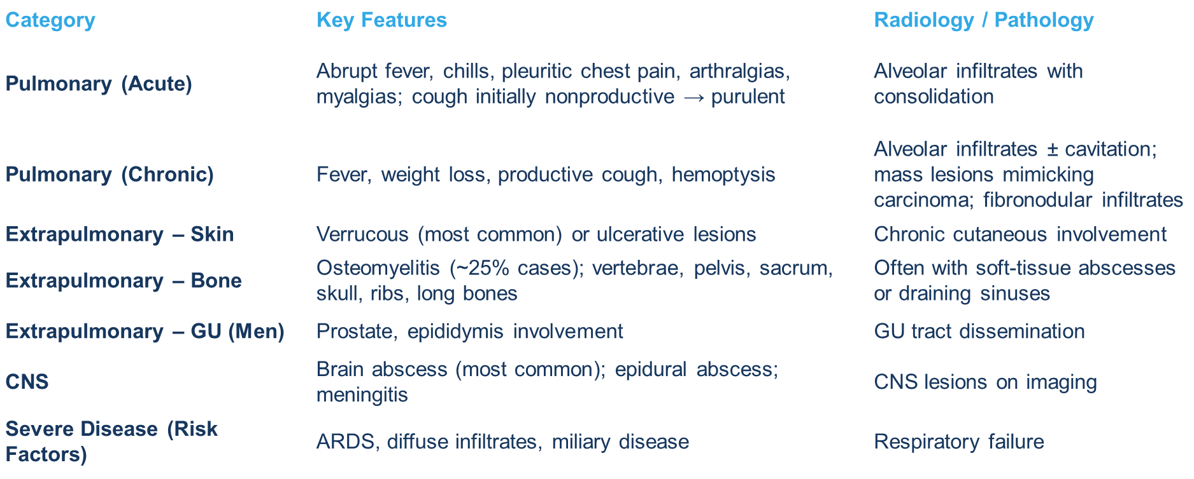

Blastomycosis- Clinical Presentation

Slide 14
Blastomycosis — Diagnosis& Treatment
Diagnosis
  Radiographic and physical exam manifestations of blastomycosis are highly non-specific
  Culture of sputum, bronchial washings, pus, or biopsy material (gold standard)
  Visible in 5–10 days, but may require up to 30 days
  Urine antigen
  Gomori Methenamine Silver (GMS) stain: broad-based budding yeast
Treatment
  Mild-moderate: Itraconazole 200 mg BD × 6–12 months
  Severe / CNS:
  LAmB 3–5 mg/kg/day → Itraconazole step-down
  Amphotericin B at a high dose of 0.7 to 1 mg/kg/day to a total dose of 1.5 to 2 grams
Thompson GR 3rd, Le T. Global guideline for the diagnosis and management of the endemic mycoses: an initiative of the European Confederation of Medical Mycology in cooperation with the International Society for Human and Animal Mycology. Lancet Infect Dis. 2021 Dec;21(12):e364–e374. doi:10.1016/S1473-3099(21)00191-2.
Notes:
Inoculated onto Sabouraud dextrose agar (with/without chloramphenicol

Slide 15
Candidiasis — Overview & Risk Factors
Candidiasis is a versatile opportunistic fungal disease spanning from self-limiting mucocutaneous infections to life-threatening deep-seated candidemia and multi-organ involvement
Pathogens: C. albicans (most common), C. glabrata, C. tropicalis, C. parapsilosis, C. auris
Risk Factors For Invasive Disease
    Central venous catheter (CVC) — most important single risk factor for candidaemia
    Broad-spectrum antibiotics — disruption of normal flora
    Immunosuppression: neutropenia, HIV, corticosteroids, transplant
    Abdominal surgery, GI perforation, pancreatitis
    TPN, prolonged ICU stay, renal replacement therap, Diabetes mellitus
Notes:
TPN- Total Parenteral nutrition

Slide 16
Candidiasis —Forms & Clinical Features
MUCOCUTANEOUS FORMS
INVASIVE CANDIDIASIS / CANDIDAEMIA
Oral thrush: white plaques on erythematous base (scrape off) — KOH: pseudohyphae
Oesophagitis: odynophagia, dysphagia — endoscopy: white plaques; AIDS-defining illness
Vulvovaginal: thick white discharge, intense pruritis, erythema
Persistent fever despite broad-spectrum antibiotics in ICU — KEY clinical clue
Endophthalmitis (dilated fundoscopy mandatory in ALL cases of candidaemia)
Endocarditis: particularly C. parapsilosis (CVC-associated)
Hepatosplenic candidiasis: 'bull's-eye' lesions on CT — post-neutrophil recovery

Slide 17
Candidiasis —Diagnosis & Treatment
Diagnosis
  Blood cultures (Gold standard) ; beta-D-glucan (BDG); mannan/anti-mannan; T2Candida panel
Mucocutaneous
  Oral thrush: Nystatin suspension or Fluconazole 150 mg single dose
  Oesophagitis: Fluconazole 200–400 mg OD × 14–21 days
  Vulvovaginal: Fluconazole 150 mg single dose; topical azoles
Invasive Candidiasis / Candidaemia
  First-line: Echinocandin (Caspofungin, Micafungin, Anidulafungin) × ≥ 14 days from last positive culture
  Step-down to Fluconazole once stable, susceptibility confirmed, no endophthalmitis
  ALWAYS remove CVC as soon as clinically feasible

Slide 18
Chronic Disseminated Candidiasis & Antifungal Drug Reference
Condition | Recommendations
Chronic disseminated (hepatosplenic) candidiasis — Initial therapy | Lipid AmB 3–5 mg/kg/d OR Echinocandin for several weeks, then Fluconazole 400 mg/d (if unlikely fluconazole-resistant isolate) Therapy continues until lesions resolve on imaging (usually several months)
Candidemia and invasive candidiasis (except CNS, eye, urinary tract) | Echinocandins Preferred for most Fungicidal; once-daily IV Dosing: Caspofungin 70 mg LD → 50 mg/d; Micafungin 100 mg/d; Anidulafungin 200 mg LD → 100 mg/d
Susceptible mucosal + invasive candidiasis | Fluconazole Standard therapy for; excellent CSF and vitreous penetration (>70% serum) Loading dose for invasive disease: 800 mg LD → 400 mg/d No activity against C. krusei; reduced activity against C. glabrata
CNS infections (higher brain tissue levels) | Liposomal AmB preferred over AmB deoxycholate for invasive disease (less nephrotoxicity) Dose: 3–5 mg/kg/d for invasive candidiasis
Susceptibility testing | Azole susceptibility testing: recommended for all bloodstream and clinically relevant Candida isolates Echinocandin susceptibility testing: in patients with prior echinocandin exposure or C. glabrata/C. parapsilosis infection C. glabrata: no established susceptibility breakpoint for fluconazole → use epidemiological cut-off values (ECV)
Pappas PG et al. IDSA Guidelines: Candidiasis. CID 2016; 62(4):e1–50.

Slide 19
Aspergillosis — Overview & Risk Factors
Diverse spectrum of pulmonary and systemic disorders caused by inhaled spores of the environmental mold Aspergillus, ranging from chronic cavitary disease to rapid angioinvasive parenchymal infection
Pathogens: A. fumigatus (most common), A. flavus, A. niger, A. terreus
Risk Factors For Invasive Aspergillosis
  Prolonged neutropenia > 10 days (haematologic malignancy, HSCT) — HIGHEST RISK
  Allogeneic HSCT, especially with GVHD on corticosteroids
  Solid organ transplant (lung > liver > renal)
  High-dose corticosteroids (≥ 0.3 mg/kg/day > 3 weeks)
  Severe influenza, COVID-19 — SARS-CoV-2-associated pulmonary aspergillosis Chronic granulomatous disease (CGD) — paediatric/young adult

Slide 20
Aspergillosis — Clinical Features
Clinical Syndrome | Clinical Presentation
Aspergilloma | Pre-existing cavity (TB, sarcoidosis) colonised; haemoptysis (can be massive)
Allergic Bronchopulmonary Aspergillosis | Asthma/CF: wheezing, proximal bronchiectasis, fleeting infiltrates; ↑ total IgE; ↑ A. fumigatus specific IgE
Invasive Pulmonary Aspergillosis (IA) | Fever unresponsive to antibiotics + pleuritic chest pain + haemoptysis in neutropenic patient HRCT: 'Halo sign' (early) — nodule with surrounding ground-glass; 'Air crescent sign' (recovery) CNS aspergillosis, endophthalmitis, skin lesions

Slide 21
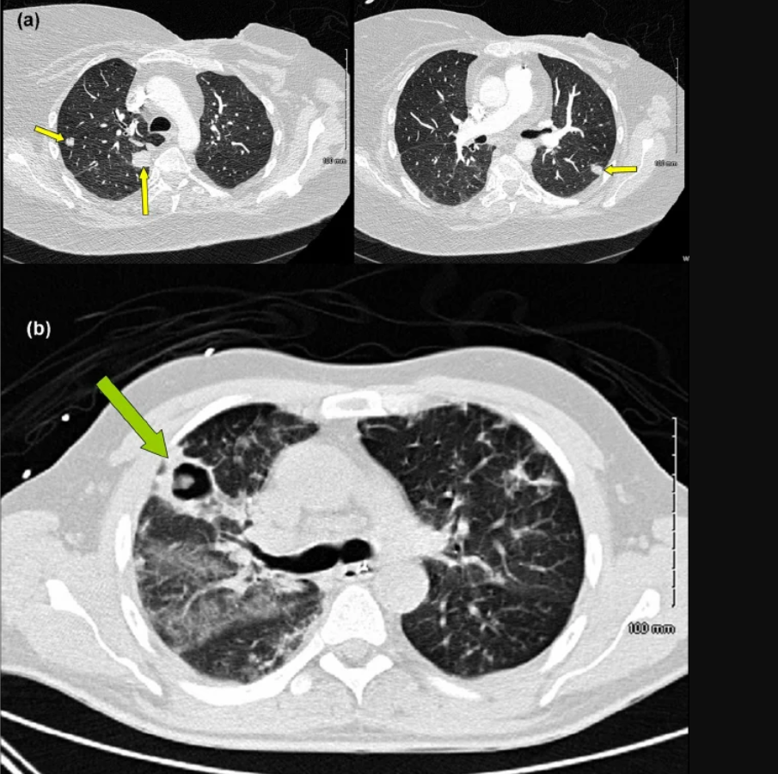
Aspergillosis — Clinical Features
Notes:
High-resolution CT of the chest showing a classic ground-glass 'halo sign' indicative of angioinvasive aspergillosis.

Slide 22
Aspergillosis — Diagnosis &Treatment
Diagnosis
  Galactomannan (serum/BAL) — high sensitivity in haematology patients
  Beta-D-glucan; BAL culture and microscopy; CT findings; tissue biopsy (gold standard)
TREATMENT
Aspergilloma
  Asymptomatic: observe; Haemoptysis: bronchial artery embolisation or surgical resection
ABPA
  Oral prednisolone + Itraconazole 200 mg BD × 4–6 months

Slide 23
Aspergillosis — Treatment & Complications
Invasive Aspergillosis — First-line
  Voriconazole 6 mg/kg IV Q12h × 2 loading doses, then 4 mg/kg IV Q12h (or 200 mg PO BD)
  Alternative: Isavuconazole — similar efficacy, fewer side effects, no QTc prolongation
  Alternative: LAmB 3–5 mg/kg/day — CNS disease, azole-refractory, drug interactions
  Duration: minimum 6–12 weeks; continue until immunosuppression reversed
PROPHYLAXIS: Posaconazole for high-risk AML/HSCT patients
COMPLICATIONS: Haemoptysis, cerebral infarction (angioinvasion), respiratory failure
Ref: Herbrecht R et al. Voriconazole vs AmB for IA. NEJM 2002; 347:408–415. | Maertens JA et al. Isavuconazole vs Voriconazole (SECURE). NEJM 2016; 374:1209–1219. | Patterson TF et al. CID 2016

Slide 24
Cryptococcosis — Overview & Risk Factors
Pathogens: C. neoformans (HIV/immunocompromised) | C. gattii (immunocompetent)
C. neoformans — worldwide (soil, bird droppings); C. gattii — tropical/subtropical regions
Risk Factors
  HIV/AIDS — CD4 < 100 cells/µL: major risk; leading cause of AIDS-defining meningitis mortality
  Solid organ transplant (especially renal and cardiac)
  Haematologic malignancies, chronic corticosteroids, anti-CD20 biologics (Rituximab)
  Cirrhosis, sarcoidosis, idiopathic CD4+ lymphopenia
  C. gattii: immunocompetent, outdoor exposure in endemic areas
Pathogenesis
  Inhalation → lung → polysaccharide capsule resists phagocytosis → CNS via 'Trojan horse' macrophages

Slide 25
Cryptococcosis — Clinical Features
Clinical Syndrome | Clinical Presentation
Pulmonary Cryptococcosis | Often asymptomatic or mild; cough, fever, dyspnoea; nodules on CXR/CT
Cryptococcal Meningitis | Most common presentation in HIV Insidious onset: fever, headache, altered sensorium; neck stiffness may be ABSENT in HIV Raised intracranial pressure (ICP) — major driver of morbidity and mortality LP: ↑ opening pressure, lymphocytes, ↑ protein, ↓ glucose India ink (budding encapsulated yeast): positive in ~80% of HIV patients
Disseminated C | Skin (molluscum-like), prostatitis (reservoir), chorioretinitis
Ref: Perfect JR et al. IDSA Guidelines for Cryptococcal Disease. CID 2010; 50(3):291–322. | Molloy SF et al. Cryptococcal meningitis and ART timing. CID 2018; 67(10):1613–1619.

Slide 26
Cryptococcosis — Clinical Features & Diagnosis
Diagnosis
  CrAg (cryptococcal antigen) — serum/CSF lateral flow assay (LFA): sensitivity > 99% in HIV meningitis
  Culture: gold standard; CSF, blood, urine
Cryptococcal Meningitis — WHO 2022 / IDSA Preferred Regimen
  Induction (2 wks): AmB deoxycholate 1 mg/kg/day + Flucytosine 25 mg/kg QDS
OR AMBITION regimen:
  Single-dose LAmB 10 mg/kg + Fluconazole 1200 mg OD × 14 days
Consolidation (8 wks): Fluconazole 400 mg OD
Maintenance: Fluconazole 200 mg OD until CD4 > 200 × 6 months (HIV)
Raised ICP Management — Critical
  Daily LP if opening pressure ≥ 25 cmH₂O — reduce by 50% or to ≤ 20 cmH₂O
No role for corticosteroids in HIV-related cryptococcal meningitis (↑ mortality)
Ref: Perfect JR et al. IDSA Guidelines for Cryptococcal Disease. CID 2010; 50(3):291–322. | Molloy SF et al. Cryptococcal meningitis and ART timing. CID 2018; 67(10):1613–1619.
Notes:
COMPLICATIONS: Raised ICP (herniation), IRIS, sensorineural hearing loss, hydrocephalus

Slide 27
Pneumocystis jirovecii Pneumonia (PJP)
Pneumocystis jirovecii Pneumonia (PJP) is a severe, life-threatening interstitial pulmonary infection targeting immunocompromised patients, particularly those with depleted cellular immunity
Pathogen: Pneumocystis jirovecii — fungus (formerly classified as protozoan)
Risk Factors
  HIV: CD4 < 200 cells/µL — commonest AIDS-defining illness in high-income settings
  Non-HIV: solid organ transplant, haematologic malignancy, long-term steroids, biologics

Slide 28
PJP- Clinical Presentation& Diagnosis
Clinical Features
  HIV: insidious onset — weeks of progressive dyspnoea, dry cough, low-grade fever, hypoxia
  Non-HIV: more acute and severe onset; higher mortality than HIV-associated PCP
Diagnosis
  Diagnosis: BAL (> 95% sensitivity); induced sputum (~60%); PCR; LDH elevated; BDG elevated
  CXR: bilateral interstitial infiltrates; CT: bilateral ground-glass ('crazy paving’)
Ref: Bozzette SA et al. Corticosteroids in PCP. NEJM 1990; 323:1451–1457. | Kaplan JE et al. IDSA/HIVMA Guidelines: Prevention of Opportunistic Infections. CID 2009; 48(Suppl 4):S16–S35.

Slide 29
PJP- Treatment
First-line: TMP-SMX 15–20 mg/kg/day (TMP component) × 21 days
Adjunct steroids: if PaO₂ < 70 mmHg — Prednisolone 40 mg BD × 5 days, then taper
Prophylaxis: TMP-SMX 1 SS tablet OD if CD4 < 200; Dapsone/Atovaquone if allergic

Slide 30
Mucormycosis (Zygomycosis)
Definition: Mucormycosis is a hyperacute, progressive, highly destructive and angioinvasive fungal disease carrying exceptionally high mortality rates.
Pathogens: Rhizopus, Mucor, Lichtheimia, Cunninghamella (Order: Mucorales)
Risk Factors
  Diabetic ketoacidosis (DKA) — hyperglycaemia + acidosis impair phagocyte function
  Deferoxamine therapy (iron chelation — provides iron for fungal growth)
  Prolonged neutropenia, haematologic malignancy, allogeneic HSCT; high-dose corticosteroids

Slide 31
Mucormycosis (Zygomycosis)
Clinical Features
  Rhino-orbito-cerebral (ROCM): sinusitis, periorbital oedema, proptosis, black eschar on palate — RAPID PROGRESSION
  Pulmonary: fever, haemoptysis, angioinvasion; CT: wedge infarcts, reverse halo sign
  Cutaneous: necrotising wound at trauma/inoculation site
DIAGNOSIS: Tissue biopsy + GMS stain: broad, pauci-septate ribbon-like hyphae branching at 90°
TREATMENT: Surgical debridement (cornerstone) + LAmB 5–10 mg/kg/day; Isavuconazole alternative; NO echinocandins
Step down to Posaconazole 300mg BID loading dose , then 300mg OD for 3-6 months (CT-guided)
Notes:
COMPLICATIONS: Cavernous sinus thrombosis, carotid invasion, cerebral infarction; mortality > 50%

Slide 32
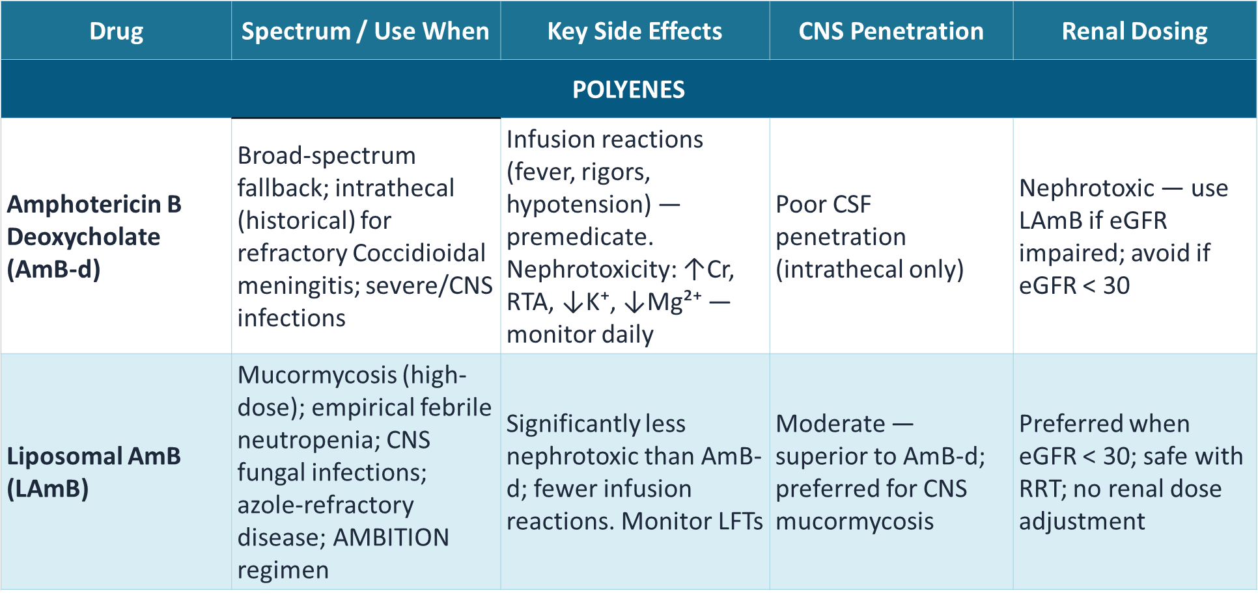
An Overview of Antifungals-1
Ref: Pappas PG et al. CID 2016; Perfect JR et al. CID 2010; WHO Fungal Priority Pathogens List 2022 | Jarvis JN et al. AMBITION Trial. NEJM 2022
Notes:
CLINICAL RULE: Candidaemia → Echinocandin (1st-line) → step-down Fluconazole | Cryptococcal meningitis induction → AmB-d + 5-FC | NEVER Echinocandin for CNS | C. auris → Echinocandin (MDR, strict isolation)

Slide 33
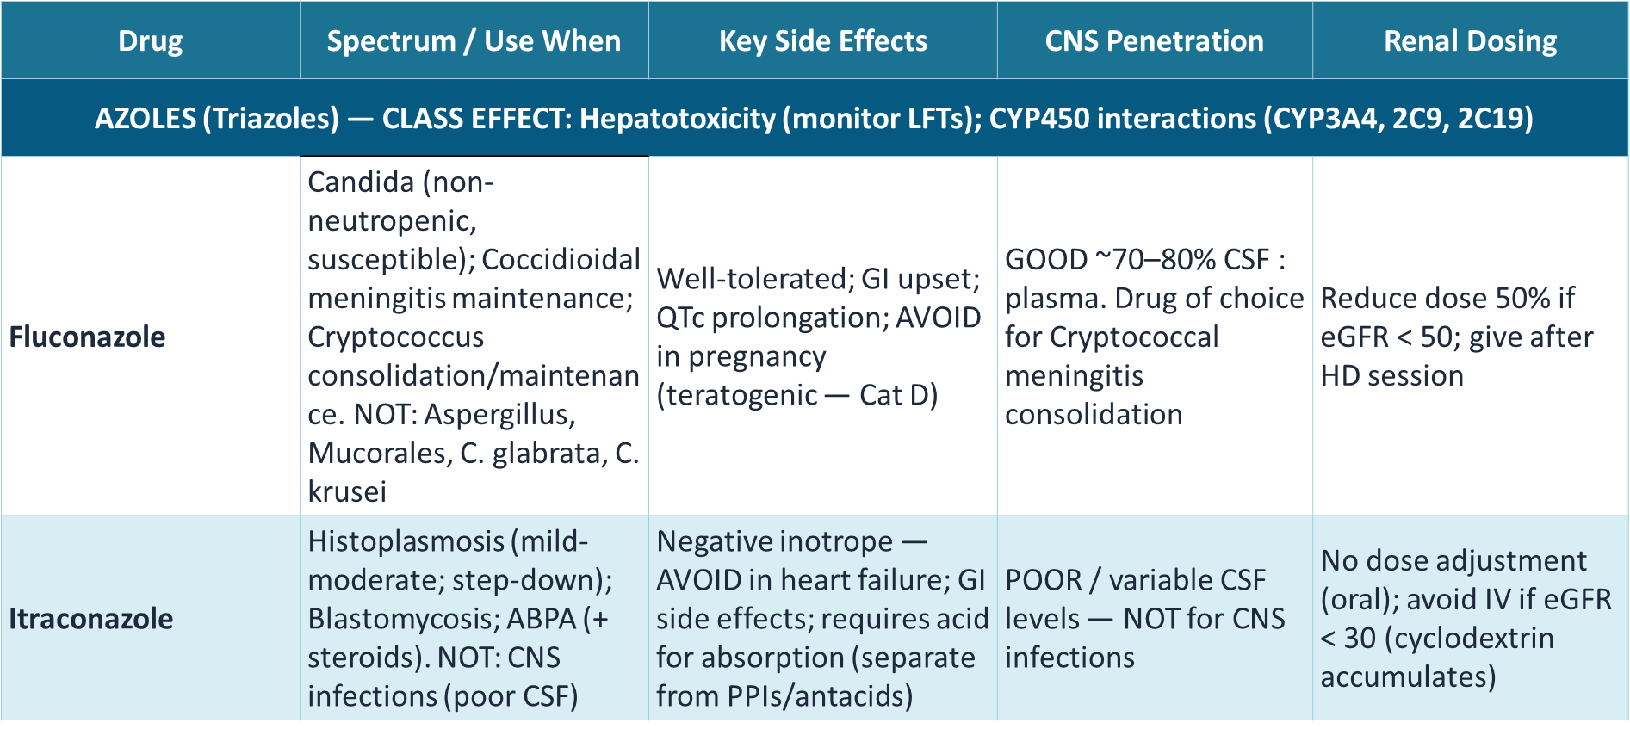
An Overview of Antifungals-2

Slide 34
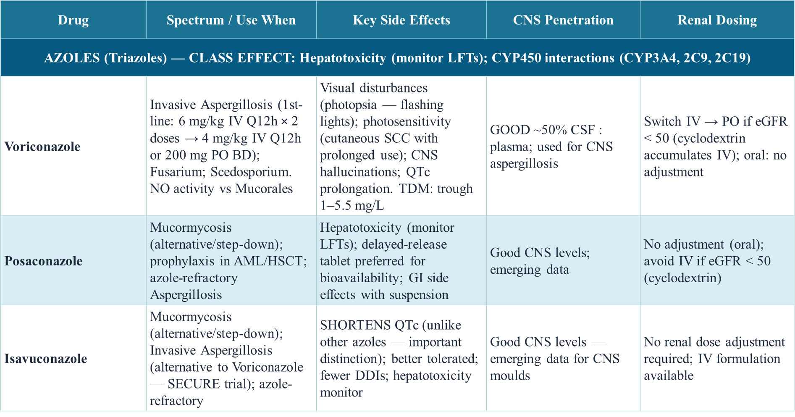
An Overview of Antifungals-3

Slide 35
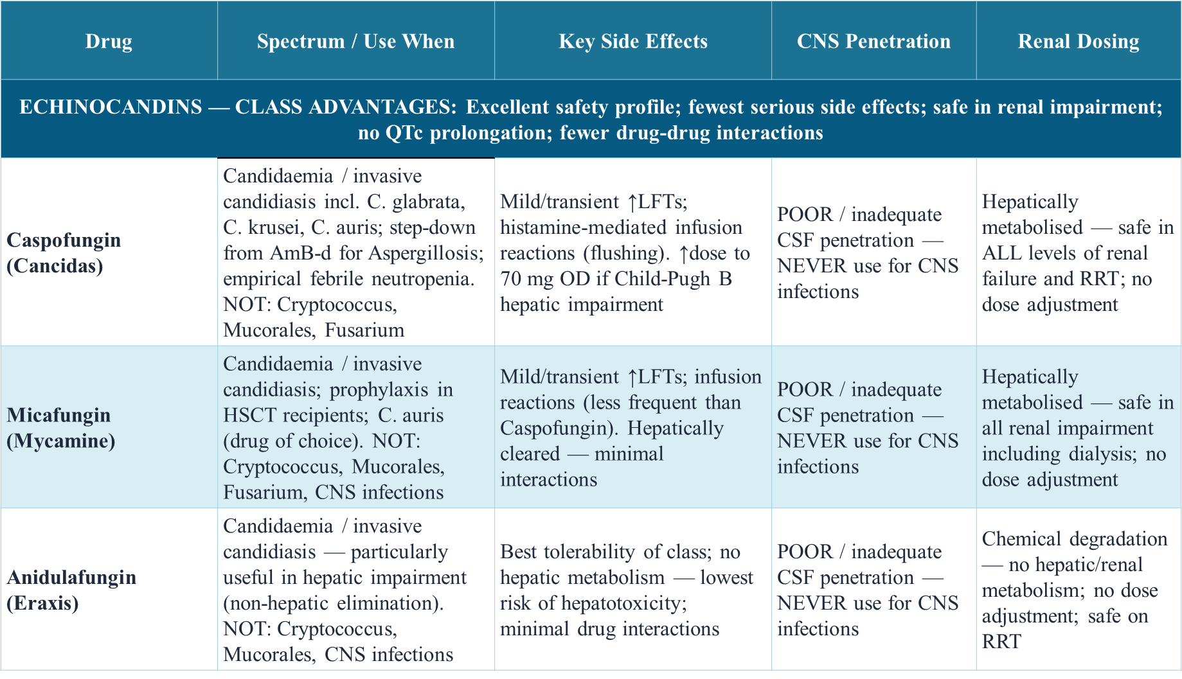
An Overview of Antifungals-4

Slide 36
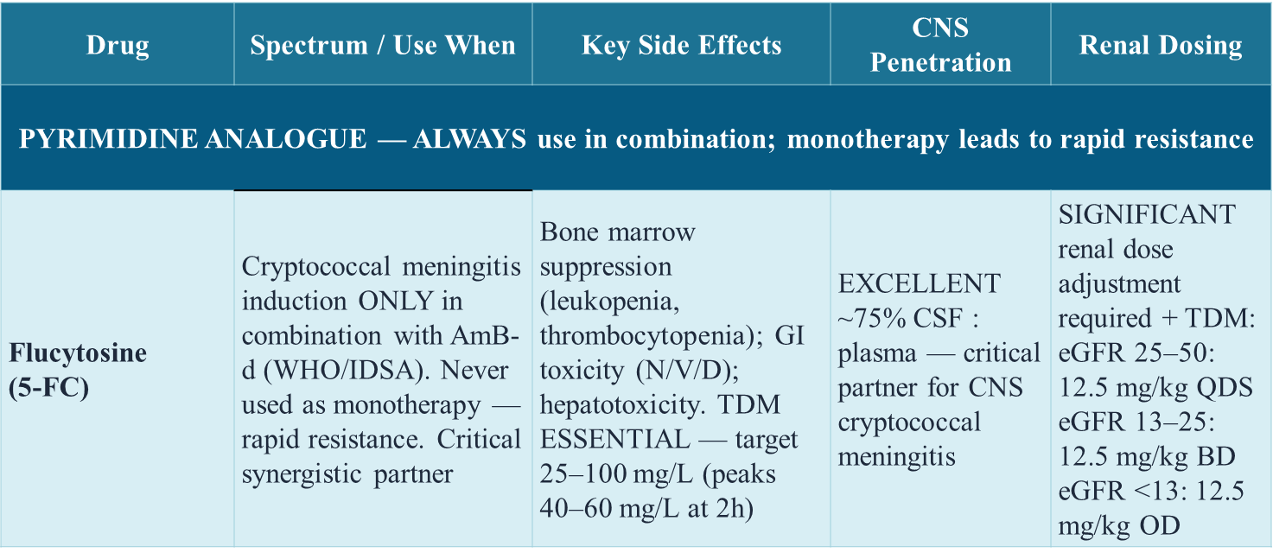
An Overview of Antifungals-5

Slide 37
Case 1
CASE
35-year-old with AML on induction chemotherapy. Day 12 post-chemo. Neutrophils 0.1 × 10⁹/L. Persistent fever × 5 days despite piperacillin-tazobactam + gentamicin.
Chest CT: dense RUL consolidation with 'halo sign'. Serum Galactomannan: 2.3 (positive ≥ 0.5)
What is the diagnosis ?
Provide management of the above diagnosis ?
What is the prevention of diagnosis?

Slide 38
Case 2
CASE
55-year-old Type 1 diabetic presenting in DKA (pH 7.15, glucose 32 mmol/L). 3-day history: facial swelling, periorbital oedema, left proptosis, black eschar on hard palate.
CT sinuses: pan-sinusitis with orbital invasion. Tissue biopsy: broad pauci-septate hyphae branching at 90°.
What is the diagnosis ?
What is the management of diagnosis above?

Slide 39
References
Wheat LJ et al. IDSA Guidelines: Histoplasmosis. CID 2007; 45(7):807–825.
Galgiani JN et al. IDSA Guidelines: Coccidioidomycosis. CID 2016; 63(6):e112–e146.
Chapman SW et al. IDSA Guidelines: Blastomycosis. CID 2008; 46(12):1801–1812.
Pappas PG et al. IDSA Guidelines: Candidiasis. CID 2016; 62(4):e1–50.
Patterson TF et al. IDSA Guidelines: Aspergillosis. CID 2016; 63(4):e1–60.
Perfect JR et al. IDSA Guidelines: Cryptococcal Disease. CID 2010; 50(3):291–322.
Cornely OA et al. ESCMID/ECMM Guidelines: Mucormycosis. CMI 2014; 20(Suppl 3):5–26.
Bozzette SA et al. Corticosteroids in Pneumocystis Pneumonia. NEJM 1990; 323:1451–1457.
Herbrecht R et al. Voriconazole vs AmB-d for IA. NEJM 2002; 347:408–415.
Maertens JA et al. Isavuconazole vs Voriconazole (SECURE). NEJM 2016; 374:1209–1219.

Slide 40
References
Day JN et al. (ACTA Trial): Cryptococcal Meningitis. NEJM 2013; 368:1291–1302.
Jarvis JN et al. (AMBITION Trial): Single-Dose LAmB. NEJM 2022; 386:1109–1120.
Kuse ER et al. Micafungin vs LAmB (MICELAN). Lancet 2007; 369:1519–1527.
WHO Fungal Priority Pathogens List. Geneva: WHO, 2022.
Mandell GL et al. Principles and Practice of Infectious Diseases, 9th ed. Elsevier, 2019.
Harrison’s Principle of Internal Medicine- 22nd Edition
Rajasingham R et al. Lancet Infect Dis 2022; Bongomin F et al. J Fungi 2017; Denning DW et al. Lancet Infect Dis 2023

